Slide 1

Module _: _
Introduction to LLM Tools for Data Analytics
Notes:
Notes that are italicized are recommendations for the lecture
Notes that are typed normally are key points

Slide 2

allwomen.tech
<
Your Basic AI Toolbox
>
‹#›
Notes:
We will see the use cases, possibilities and limitations of relying on ChatGPT for DA

Slide 3
Module 1: Prompt Engineering
LLM Based Tools to support your Data Analysis
ChatGPT
Uses GPT-4 to store and retrieve information in a conversational style
Vanna.AI
Query using plain english that allows users to generate SQL without writing code
Perplexity
Combines LLMs and RAG with search engines to answer queries
Hugging Face
Collection base for hosting and finding pre-trained LLMs for NLP, great to combine with other models for various tasks and for deployment
Ollama
Bonus! Locally hosted LLM
Notes:
Short intro to what they will see throughout the lesson - just some examples of things that can enhance existing knowledge, still best to use with prior knowledge of coding, SQL, and of course the basics of DA

Slide 4
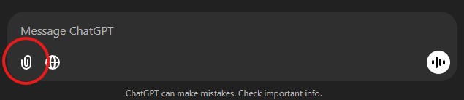
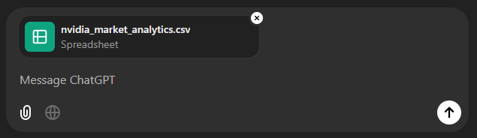
Module 1: Prompt Engineering
“Talking” to your Data via ChatGPT
With prompt engineering and any *cleaned* data file you can do an initial analysis and “chat with” your data
INTERACTING WITH TABLES IN CHATGPT
Load your file
Notes:
This is one of the most used proprietary LLMs on the market

Slide 5
Module 1: Prompt Engineering
“Talking” to your Data via ChatGPT
With prompt engineering and any *cleaned* data file you can do an initial analysis and “chat with” your data
INTERACTING WITH TABLES IN CHATGPT
Load your file

Slide 6
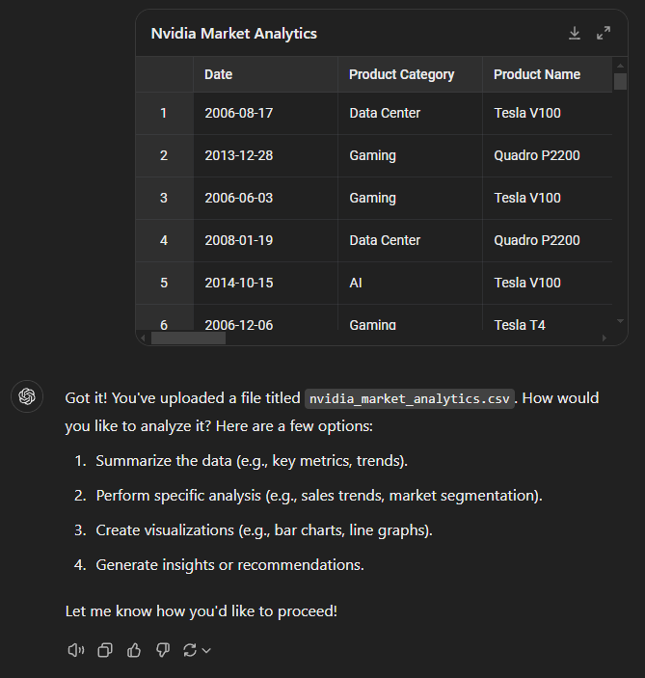
Module 1: Prompt Engineering
“Talking” to your Data via ChatGPT
Interact directly
Notes:
Your table (csv) can be previewed directly

Slide 7
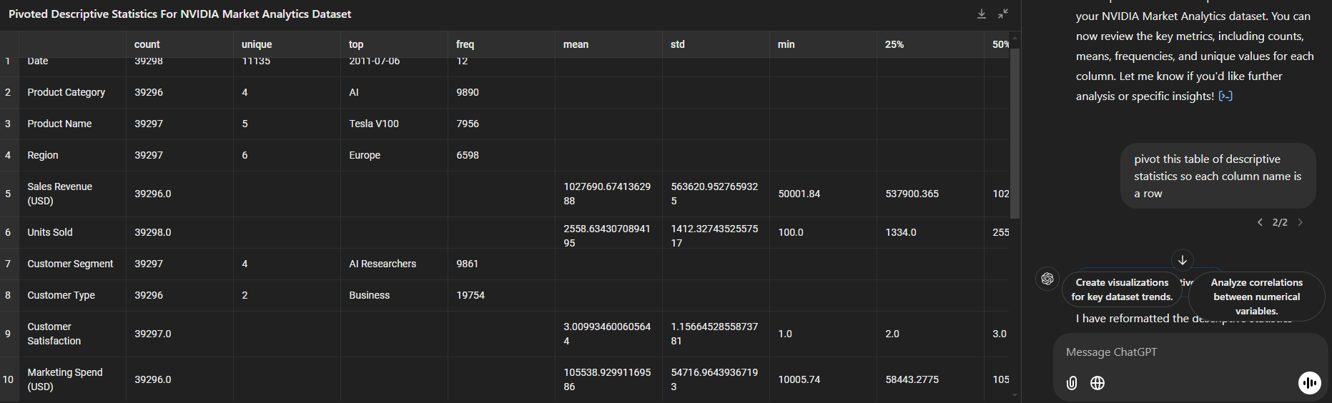
Module 1: Prompt Engineering
“Talking” to your Data via ChatGPT
Interact directly
You can do almost anything you’ve been doing with EDA, directly into ChatGPT
Notes:
Initial EDA steps like creating dataframes, pivoting tables, seeing the descriptive statistics can be done.
You can download the tables that are created for you as well.

Slide 8
Module 1: Prompt Engineering
Prompt Engineering and EDA
Be as specific as possible: By crafting specific prompts, you reduce ambiguity, helping the AI understand the context and nuances of your request.
What type of Data Analysis is ChatGPT capable of?
Anomaly Detection: it can identify missing data, duplicates, NAs, incorrect data types.
Descriptive Statistics: Sums, min-max values, counts, stds.
Merging Tables: merging tables to enrich datasets on a common key
Advanced Statistical Analysis: uni to multivariate analysis, regressions, time series (limited)

Slide 9
Module 1: Prompt Engineering
Prompt Engineering and EDA
Be as specific as possible: By crafting specific prompts, you reduce ambiguity, helping the AI understand the context and nuances of your request.
What type of Data Analysis is ChatGPT capable of?
Anomaly Detection: “Check this data for common issues.”
Descriptive Statistics: “Give me descriptive statistics of this dataset”
Merging Tables: “Associate X table with Y table on id_123”
Advanced Statistical Analysis: “Create a correlation table”

Slide 10
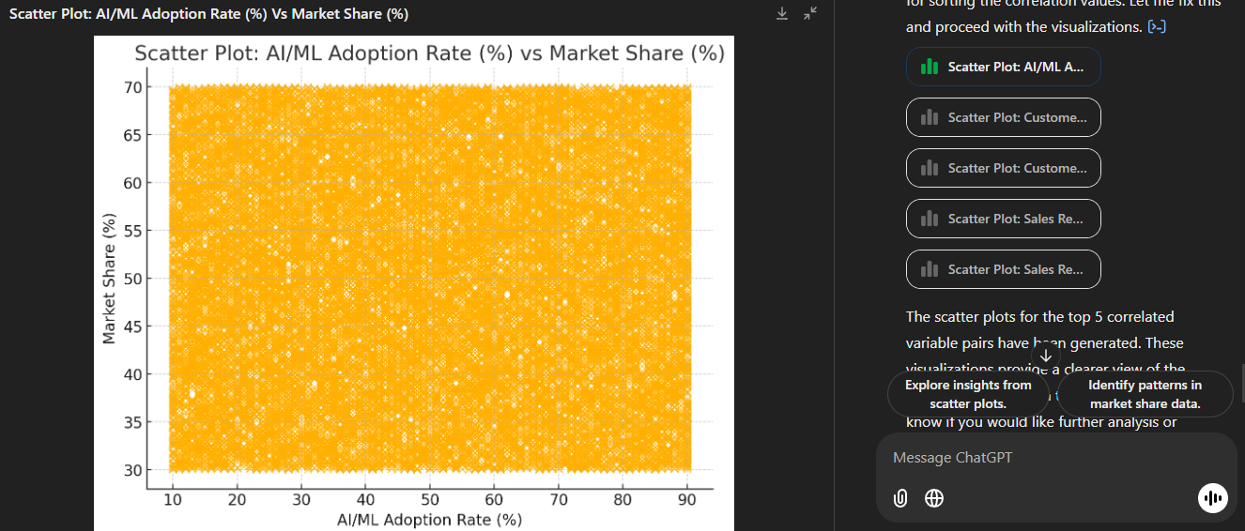
Module 1: Prompt Engineering
“Talking” to your Data via ChatGPT - Limitations
Visualizing Data
You can do almost anything you’ve been doing with EDA, directly into ChatGPT - ALMOST
Notes:
Important to remind students not to completely rely on ChatGPT as it will become more of a crutch rather than a useful tool
Chat GPT is good for tedious tasks, but I highly recommend using what you’ve learned and double-checking everything with your notebooks and Python scripts - as you can see here

Slide 11
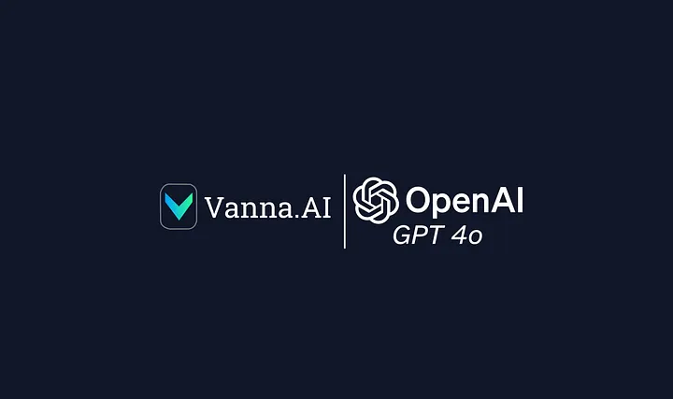
Module 1: Prompt Engineering
SQL with Vanna
Notes:
Text to SQL Pipelines using natural language - demo

Slide 12
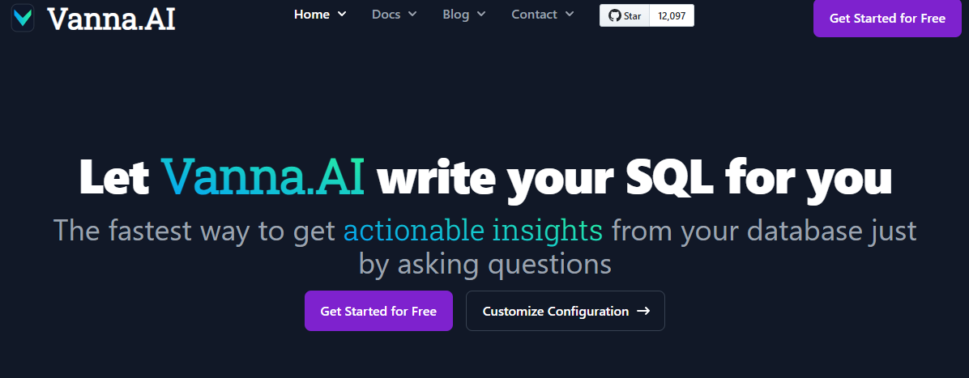
Module 1: Prompt Engineering
SQL
https://vanna.ai/blog/ai-sql-accuracy.html
Notes:
For those that find themselves still unsure about SQL but have more sources in .db format,

Slide 13
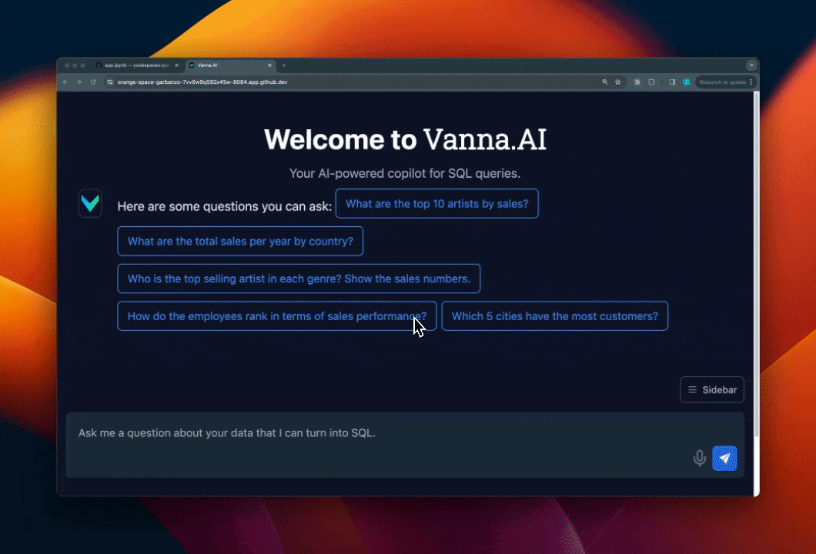
Module 1: Prompt Engineering
Connecting to Databases with Vanna
Built-In
Postgres SQL
Oracle
DuckDB
MySQL
SQLite
Big Query
Snowflake
Microsoft SQL
Notes:
[demo it after this slide]

Slide 14
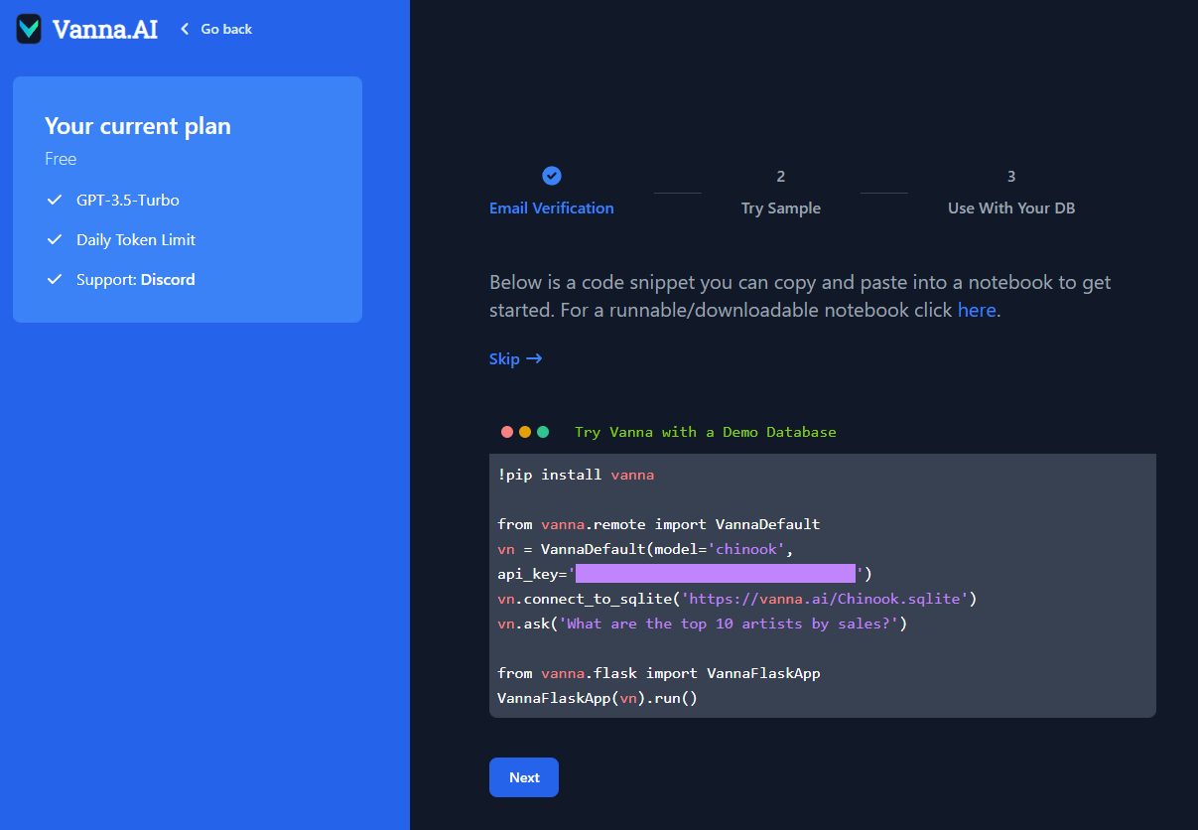
Module 1: Prompt Engineering
Connecting to Databases with Vanna
Built-In
Postgres SQL
Oracle
DuckDB
MySQL
SQLite
Big Query
Snowflake
Microsoft SQL
Notes:
[demo it after this slide]

Slide 15
Module 1: Prompt Engineering
Features
BENEFITS:
Saves time on query writing, but previous knowledge of SQL still beneficial for debugging
Makes database interaction much easier
USE CASES:
Similar to what you can do with ChatGPT but more geared towards data analysis using SQL
Speak to it conversationally and it will translate your queries into SQL queries
Quick insights, quick queries
Notes:
[demo it after this slide]

Slide 16

Module 1: Prompt Engineering
Example Use
INPUT: “What was the average monthly sales by country in 2024?”
OUTPUT:
💡Think of Vanna as a better SQL Copilot!
Notes:
[Teacher demo it after this slide] - use common queries , use databases that they might have used/will use in SQL week

Slide 17
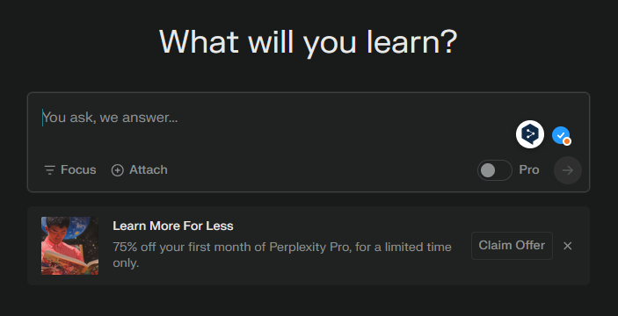
Module 1: Prompt Engineering
Perplexity - your new search engine
Perplexity, compared to ChatGPT uses online sources to generate accurate and consistent responses vs fetching information from its training data
Notes:
LLMs with access to external sources have a higher chance of giving more accurate responses. Even though ChatGPT, Gemini, and Copilot can all use the internet, the first two were built as chatbots, but Perplexity’s purpose is to be a replacement for search engines itself

Slide 18
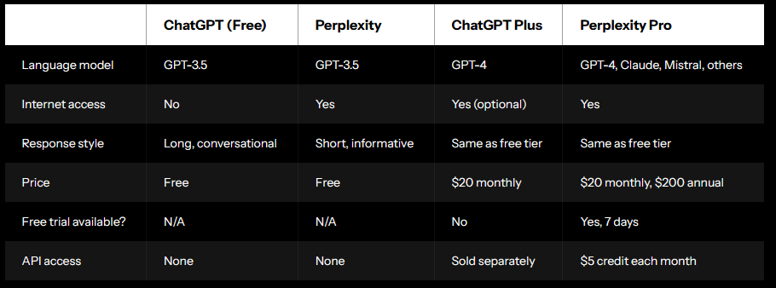
Module 1: Prompt Engineering
Perplexity to gather context on data
AI Powered Search Engine: answers to prompts using real-time information from online sources, useful for providing context to the data that you just analyzed with ChatGPT.
Notes:
Teacher demo to compare results in Perplexity vs Google, Bing, or DuckDuckGo for example

Slide 19
Module 1: Prompt Engineering
Perplexity to gather context on data
AI Powered Search Engine: answers to prompts using real-time information from online sources, useful for providing context to the data that you just analyzed with ChatGPT.
Things to consider
It will always show sources, but you have to double-check if those sources are reliable
Because of the prevalence of AI written articles, you will start to see more and more results that are also done by AI

Slide 20
allwomen.tech
<
LLMs - Under the Hood
>
‹#›

Slide 21
Module 1: Prompt Engineering
Vocab
Terms | Definitions
Prompt | How you interact with the chatbot in the form of instructions
Tokens | Converted input data (usually words separated into smaller units) and output of LLMs
Embedding | Numerical representation of words or tokens in a vector space - makes it easier to compute relationships
Parameters | Weights learned by the model during training
Pre-training | First part of training involving learning the structure of the language and general knowledge
Fine-tuning | Using a pre-trained model and adapting it to a specific task or domain
Hallucinations | Output that is made-up or non-sensical
Foundation model | General purpose ML model trained on a lot of different types of data ex. GPT, BERT, DALL-E
Latency | The speed of which your model responds
Notes:
Important to introduce vocabulary early on
Example:
A foundation model is built through extensive pre-training on large datasets, learning millions or billions of parameters to capture language patterns. When given a prompt, the model processes it by breaking it into tokens and mapping these into numerical representations called embeddings. While the pre-trained model can handle many tasks, fine-tuning on specific domains improves accuracy. However, challenges like hallucinations, where the model generates incorrect outputs, and latency, the delay in response time, remain important considerations for practical deployment.

Slide 22
Module 1: Prompt Engineering
Intro to LLMs
AI Models trained on vast datasets to understand and generate human-like text.
Core Characteristics
Large-scale parameters (billions to trillions)
Data sources include many different data types
Many of these AI models are trained for the tasks that you use every day:
Translation, chatbots, summary detection, bank security, etc

Slide 23
Module 1: Prompt Engineering
How do LLMs work?
Transformer-based architecture for many LLMs. Processes information in chunks using the attention mechanism to figure out which parts of the input are the most important.
Training and Input
Pre-trained on unimaginably huge datasets - books, documents, websites, etc. Allowing models to develop a level of understanding of the language.
Fine-tuned or combined with a RAG model for specific tasks and domains - this just means they can be tweaked for specific use-cases, and can be used with a RAG model to fetch external data and update outputs.
Output:
Context-aware responses whose quality improves with the training data size and the model architecture

Slide 24
Module 1: Prompt Engineering
Proprietary vs Open Source LLMs
Proprietary (GPTx.x, Claude, etc) | Open Source (LLaMA, BLOOM)
High Performance | Performance Gap
Continuous Improvement | Maintenance Burden
Enterprise-ready | Limited enterprise support
Lack of Transparency | Transparent
Vendor-dependence | Self-hosting and migration is relatively easy
Subscription/usage-based pricing | Cost-effective - pay for hosting only
Limited control | Customizable
Privacy issues | Licensing issues
 | Resource-intensive
 | Community Support
Notes:
Recommend to go through each row and cite the importance here, and that there will not be a clear winner, and sometimes it is useful to mix the use of both types. Since they’ve already seen examples of proprietary LLMs we’ll explore Open Source LLMs in the next slides Proprietary often require paid access or a license to use
Open source often requyire a little bit more technical knowhow to customize but is a lot more transparent in terms of develpoment
Choose what is appropriate based on your needs. Some pros and cons weigh heavier than the others.

Slide 25
allwomen.tech
<
Exploring Open Source LLMs
>
‹#›

Slide 26
Module 1: Prompt Engineering
Intro to Hugging Face
What you need:
[LIVE DEMO] Step by Step:
Google CoLab
Hugging Face [link]
Basic Python
Create a new notebook in Colab
Runtime > Change runtime type > Hardware accelerator > GPU > Save
Use !pip install to add Hugging Face libraries with: transformers, datasets, tokenizers
Select a model from the hub
look at its usage page [let’s use sentiment analysis]
Copy the code into Colab and use it with pipeline
Initialize
Run a sample!
Rinse and repeat as needed, exploring different models for different tasks
Notes:
This is a teacher demo based on https://dev.to/ajmal_hasan/using-hugging-face-models-in-google-colab-a-beginners-35ll - sentiment analysis is the easiest to set up but it can also be done with computer vision and audio, which can be fun for students to see
Super easy to follow and a good intro without needing a good computer and will build on what they’ve learned with the basics of python and using notebooks

Slide 27
allwomen.tech
<
Use Case - Running Your Own LLMs locally with Ollama
>
‹#›

Slide 28
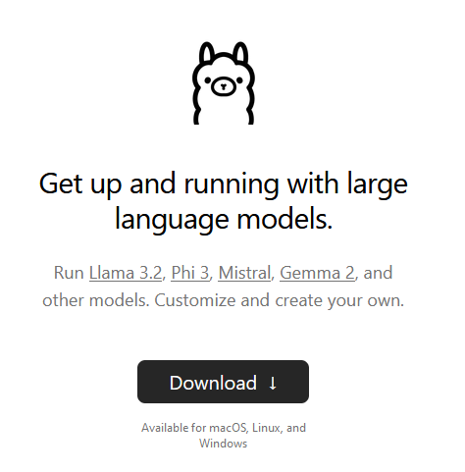
Module 1: Prompt Engineering
Use An LLM Locally
What is your purpose?
Tailor to specific use cases
Privacy and control
Steps:
Choose a base model
Fine-tune with your own data
Optimize
Monitor
Deploy to the cloud or locally
Notes:
Let’s see what it would be like to run a local only LLM - here we assume we can use this LLM offline (which they can)
Great for if you find yourself offline
Not too bad on normal notebooks and computers
I love this because it “democratizes access” to LLMs, anyone can run their own. I’ve used this for long flights when I had no access to the internet.

Slide 29
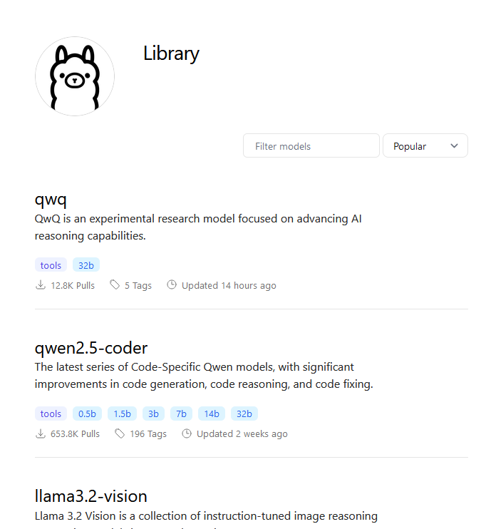
Module 1: Prompt Engineering
Ollama
Omni-Layer Learning Language Acquisition Model
“Developed with a vision to empower individuals and organizations, Ollama provides a user-friendly interface and seamless integration capabilities, making it easier than ever to leverage the power of LLMs for various applications and use cases.”
Geeks for Geeks
Available for Linux, macOS, Windows
Comfortable use of CLI is a + but not a strict requirement
Notes:
Multiple models for you to explore and run locally on your machine
Once downloaded you don’t need an internet connection

Slide 30
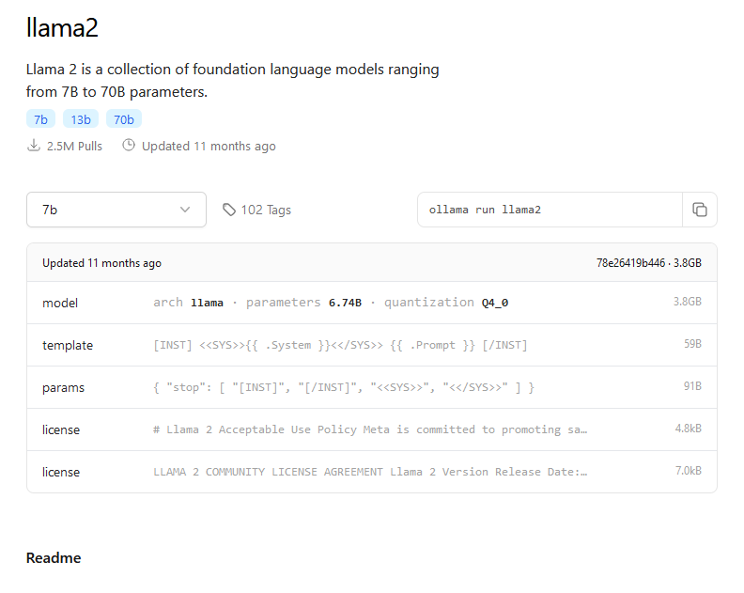
Module 1: Prompt Engineering
Local LLM
Notes:
Just go through the model page and explain what this means, where to download the model, how to use it

Slide 31
Module 1: Prompt Engineering
Some Models to Start
model
llama2 | From Meta gene - 7b, 13b, 70b parameters
Gemma | Open source, comparative to other 7B weight models
LlaVa | Image to text with support for vision and language models
Notes:
Certain models are trained on specific datasets, making them ideal for tasks like code completion, conversation, or image-to-text processing. On Ollama, you'll discover models tailored to a variety of needs - we can use just llama2 here to introduce you to how powerful transfer learning can be
DEMO - show how to install and use Ollama

Slide 32
allwomen.tech
<
Thank you! Gracias! Merci!
hello@allwomen.tech
allwomen.tech
>

